Slide 1

二进制输入输出
MIS, School of Information, RUC

Slide 2
JAVA输入输出
程序
输入对象由
输入类产生
输出对象由
输出类产生
输入流
文件
0101…1001
输出流
文件
11011…1011

Slide 3
文本I/O与二进制I/O
文本I/O程序
字符的统一码
比如“199”
字符编码存储在文件中
00110001 00111001 00111001
编码/解码
0x31
0x39
0x39
二进制I/O程序
读/写一个字节
比如199
文件中是同样的字节
0110111
0xC7

Slide 4
二进制I/O类
FileInputSream
DataInputSream
InputStream
FilterInputSream
BufferedInputSream
ObjectInputSream
Object
FileOutputSream
DataOutputSream
OutputStream
FilterOutputSream
BufferedOutputSream
ObjectOutputSream

Slide 5
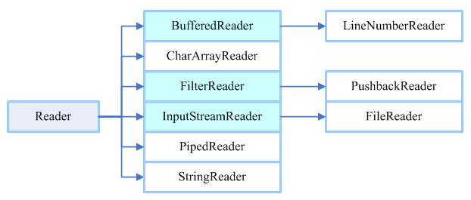
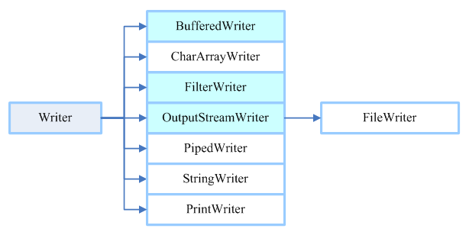
文本I/O类

Slide 6
举例
FileInputStream类和FileOutputStream类
例TestFileStream.java
DataInputStream类和DataOutputStream类
接口 DataInput, DataOutput
例TestDataStream.java
BufferedInputStream类和BufferedOutputStream类
实例：copy.java
原书第7版 19章

Slide 7
对象输入输出
ObjectInputStream和ObjectOutputStream
接口DataInput,DataOutput
可代替DataInputStream和DataOutputStream
例: TestObjectOutputStream.java, TestObjectInputStream.java
接口Serializable
标记性接口。没有方法，实现Serializable接口不需要添加代码，要实现这个接口可以启动java的序列机制，自动执行存储对象和数据的过程。
例：TestObjectStreamForArray.java

Slide 8
随机读写文件
RandamAccessFile类
实现接口DataInput,DataOutput
例：TestRandomAccessFile.java

Slide 9
网络
基于流的通信
TCP
基于包的通信
UDP
引入包java.net

Slide 10
建立连接
服务器
服务器主机
客户端主机
步骤 1：使用下面的语句在端口（如8000）上创建服务器套接字 ServerSocket serverSocket=new ServerSocket(8000);
步骤2：使用下面的语句创建连接到客户的套接字:
Socket socket= serverSocket.accept();
步骤3：客户程序使用下面的语句来连接到服务器：
Socket socket=new Socket(ServerHost,8000);
网络
I/O流

Slide 11
数据传输
服务器
客户端主机
服务器主机
Int port=8000;
DataInputStream in;
DataOutputStream out;
ServerSocket server;
Socket socket;
server=new ServerSocket(port); socket= socket.accept();
in= new DataInputStream(socket.getInputStream());
Out=new DataOutputStream(socket.getOutputStream());
System.out.println(in.readDouble());
out.writeDouble(aNumber);
Int port =8000;
String host=“loalhost”;
DataInputStream in;
DataOutputStream out;
Socket socket;
Socket t=new Socket(host, port);
in= new DataInputStream(socket.getInputStream());
Out= new DataOutputStream(socket.getOutputStream());
out.writeDouble(aNumber);
System.out.println(in.readDouble());
连接请求
I/O流

Slide 12
举例
客服端发送数据，服务器生成结果，返回给客户端
Server.java, Client.java
计算面积
半径
服务器
客户端
面积

Slide 13
Server
radius
Client
radius
DataInputStream
DataOutputStream
socket.getInputStream
socket.getOutputStream
socket
socket
network
Server
area
Client
area
DataOutputStream
DataInputStream
socket.getOutputStream
socket.getInputStream
socket
socket
network

Slide 14
socket
服务器
0
1
2
.
.
.
.
.
.
0
1
2
.
.
.
.
.
.
客户端
2047
端口号
端口号
8000

Slide 15
举例
InetAddress类
获取客户端的主机名和IP地址。
对IP地址建模
InetAddress inetAddress=socket.getInetAddress();
还可通过静态方法getByName通过主机名或IP创建一个InetAddress的实例
InetAddress address=InetAddress.getByName(“localhost”);
例 IdentifyHostNameIP.java

Slide 16
举例2
服务多个客户
多线程
MultiThreadServer.java
服务器
端口上的服务
器套接字
客户端套接字
客户端套接字
客户端1
…
客户端n

Slide 17
发送和接受对象
客户端程序从客户端采集学生信息，并将这些信息发给服务器。
Student.java
StudentClient.java
StudentServer.java

Slide 18
从Web服务器上读取文件（可选）
Web服务器
互联网
独立的应用程序
本地文件
Web浏览器
Applet读取文件
例子： ViewRemoteFile.java

Slide 19
The URL 类
Audio and images are stored in files. The java.net.URL class can be used to identify the files on the Internet. In general, a URL (Uniform Resource Locator) is a pointer to a "resource" on the World Wide Web. A resource can be something as simple as a file or a directory. You can create a URL object using the following constructor:
public URL(String spec) throws MalformedURLException
For example, the following statement creates a URL object for http://www.sun.com:
try {
URL url = new URL("http://www.sun.com");
}
catch(MalformedURLException ex) {
}

Slide 20
创建一个URL实例
To retrieve the file, first create a URL object for the file. The java.net.URL. For example, the following statement creates a URL object for http://www.cs.armstrong.edu/liang/index.html.
URL url = new URL("http://www.cs.armstrong.edu/liang/index.html");
You can then use the openStream() method defined in the URL class to open an input stream to the file's URL.
InputStream inputStream = url.openStream();

Slide 21
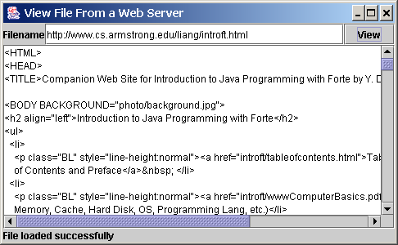
Example: Retrieving Remote Files
This example demonstrates how to retrieve a file from a Web server. The program can run as an application or an applet. The user interface includes a text field in which to enter the URL of the filename, a text area in which to show the file, and a button that can be used to submit an action. A label is added at the bottom of the applet to indicate the status, such as File loaded successfully or Network connection problem.
ViewRemoteFile
Run

Slide 22
JEditorPane类
GUI组件，能够自动显示普通文本文件、HTML文件和RTF文件
例子WebBrowser.java

Slide 23
JEditorPane
Swing provides a GUI component named javax.swing.JEditorPane that can be used to display plain text, HTML, and RTF files automatically. So you don’t have to write code to explicit read data from the files. JEditorPane is a subclass of JTextComponent. Thus it inherits all the behavior and properties of JTextComponent.
To display the content of a file, use the setPage(URL) method as follows:
public void setPage(URL url) throws IOException
JEditorPane generates javax.swing.event.HyperlinkEvent when a hyperlink in the editor pane is clicked. Through this event, you can get the URL of the hyperlink and display it using the setPage(url) method.

Slide 24
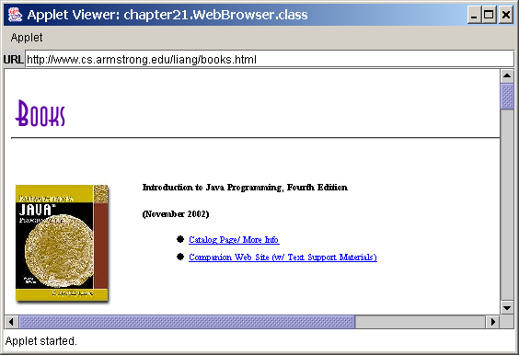
Example: Creating a Web Browser
Viewing HTML Files Using the JEditorPane. JEditorPane can be used to display HTML files.
WebBrowser
Run

Slide 25
案例: 分布式TicTacToe游戏
TicTacToeServer
Run Server
TicTacToeClient
Run Client

Slide 27
玩家1
1.初始化用户界面
2.请求连接服务器,并从服务
器获知使用哪个标记
3.从服务器获取开始信号
4.等待玩家标记一个单元格,
将这个单元格的行列索引给服务
5.从服务器接收状态
6.如果状态为WIN,显示赢家;如果玩家2获胜,接受玩家2的最后一步移动。打断循环。
7．如果状态为DRAW，显示游戏结束；打断循环。
8．如果状态为CONTINUE，获取玩家2选中的行列索引并标记该单元格。
服务器
创建服务器套接字
接受来自第一个玩家的连接并且通知玩家谁是使用标记X的玩家1
接受来自第二个玩家的连接并且通知玩家1谁是使用标记O 的玩家2
启动会话线程
1.通知玩家1开始
2.接收来自玩家1的被选中单元格的行列索引
3.确定游戏状态（WIN,DRAW,CONTINUE）。如果玩家1获胜或者平局，就发送状态（PLAYER1_WON, DRAW）给两个玩家，然后发送玩家1的移动给玩家2.提出。
4. 如果状态为CONTINUE,则通知玩家2进行行动，然后发送玩家1新选中的行列索引给玩家2
5.接收来自玩家2的被选中单元格的行列索引
6.如果玩家2获胜，就发送状态（PLAYER2_WON）给两个玩家，然后发送玩家２的移动给玩家１，退出。
7.如果状态为CONTINUE,则发送这个状态，然后发送玩家２新选中的行列索引给玩家１
玩家2
初始化用户界面
请求连接服务器，并从服务器获知使用哪个标记
从服务器接受状态
如果状态为WIN，显示获胜者。如果玩家1获胜，就接收玩家1的最后一次移动，然后打断这个循环
如果状态为DRAW，显示游戏结束，并接收玩家1的最后一次移动，然后打断这个循环。、
如果状态为CONTINUE，就接收玩家1的被选中的行列索引，并标记该单元格。
等待玩家去移动，并将选中的行列索引发送给服务器。

Slide 28
基于包的通信
不可靠的连接
DatagramSocket类
DatagramPacket类
例子：
DatagramClient.java
DatagramServer.java

Slide 29
DatagramPacket类

Slide 30
DatagramSocket 类
DatagramSocket
Create a server DatagramSocket
Create a client DatagramSocket
The DatagramSocket class represents a socket for sending and receiving datagram packets. A datagram socket is the sending or receiving point for a packet delivery service. Each packet sent or received on a datagram socket is individually addressed and routed. Multiple packets sent from one machine to another may be routed differently, and may arrive in any order.
To create a server DatagramSocket, use the constructor DatagramSocket(int port), which binds the socket with the specified port on the local host machine.
To create a client DatagramSocket, use the constructor DatagramSocket(), which binds the socket with any available port on the local host machine.

Slide 31
Sending and Receiving a DatagramSocket
Sending
Receiving
To send data, you need to create a packet, fill in the contents, specify the Internet address and port number for the receiver, and invoke the send(packet) method on a DatagramSocket.
To receive data, create an empty packet and invoke the receive(packet) method on a DatagramSocket.

Slide 32
Datagram Programming
Datagram programming is different from stream socket programming in the sense that there is no concept of a ServerSocket for datagrams. Both client and server use DatagramSocket to send and receive packets.
Designate one a server

Slide 33
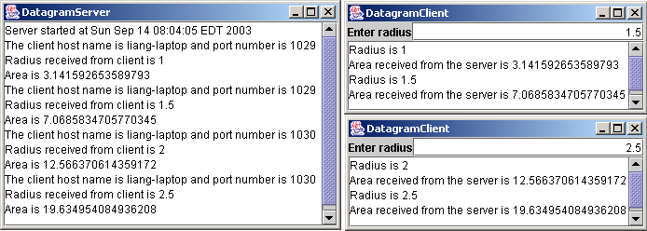
例子: A Client/Server Example
A client program and a server program using socket streams. The client sends radius to a server. The server receives the data, uses them to find the area, and then sends the area to the client. Rewrite the program using datagram sockets.
Server Code
Client Code
Note: Start the server, then the client.
Start Server
Start Client

Slide 34
作业
完成拷贝文件。
完成从客户端上载文件到服务器端功能
完成服务器端下载文件到客户端功能
完成拷贝文件的进度条功能

